Slide 1
Embedded Class 6
UART Driver

Slide 2

Agenda
Project Directory Structure
Review what a UART is
Why do we want a UART
GPIO Pin Mux
UART Driver lab

Slide 3
Notes
This is not easy
Writing drivers is hard
Writing good drivers is even harder
Datasheets are confusing
All Datasheets suck in their own way
They all make you feel ignorant and confused
Writing drivers requires Grit
You must keep working and working and working until you understand
You will read datasheet multiple times trying to figure out why things don’t work.
Remember it is OK to learn from others (use google)

Slide 4
Project Directory Structure
Drivers
Contains drivers for the chip level peripherals
Libraries
Contains reusable library of code
Example is a library to implement a FIFO

Slide 5
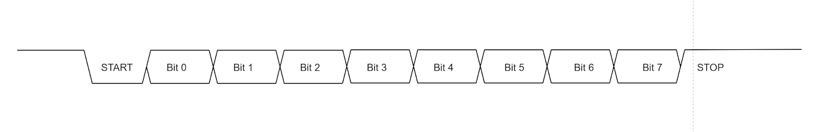
What is a UART
UART is an acronym for universal asynchronous receiver-transmitter
Baud rate is the bit rate
Bytes per second is baud rate/10 (assuming 1 stop bit)
What happens if the start bit gets out of sync?

Slide 6
Purpose of UART
What happens if the code has an error?
Using a UART and the USB serial cable we can see error in PC
Great for use in production
Can check errors, issue commands, etc
Why not SWO, RTT, or USB
USB – if you stop on a break point with USB the host PC will disconnect
SWO – Only an output, not good for use in factory to set parameters
Requires a JTAG adapter that supports it
RTT –Only on Segger debuggers which we have
Must have debugger
Not good for factory
Semi-Hosting – similar to RTT

Slide 7

Debug Terminal Output
Ideally would not affect code timing
Would not take any code space
Would not use any RAM
Heck, ideally you would not ever need to debug code
We will discuss debugging in more in detail Monday

Slide 8
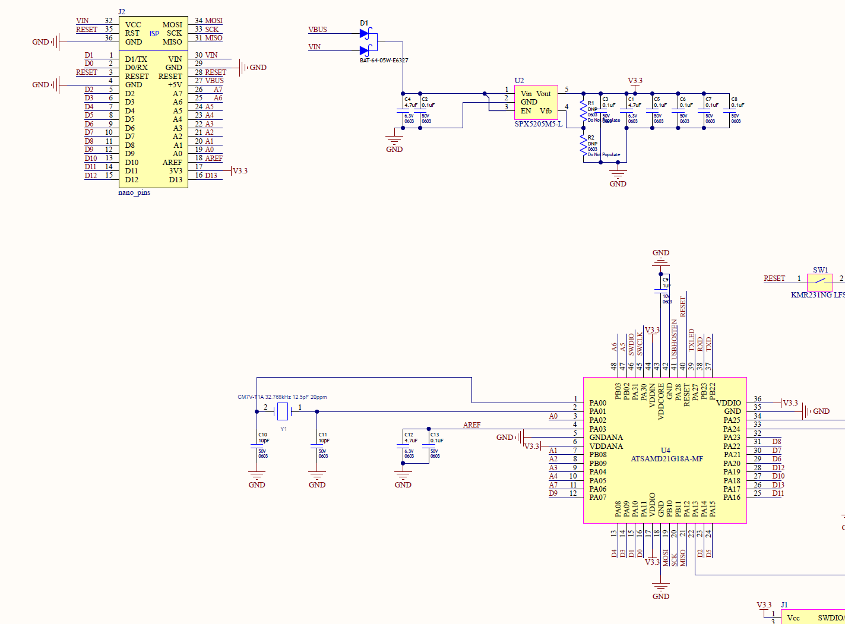
Which Pins to use
PA08 (D4), PA09 (D5)

Slide 9
GPIO Pin Mux
Each Processor is different!!!!
SAMD21 requires mapping pin to the peripheral you want to use

Slide 10

Lets Code
Let’s start coding….
Configure pins for correct peripheral
Configure the UART
Send a character out the UART
Test with logic analyzer/scope or USB to serial cable

Slide 11
Hints – Yea you need them
UART will need to have the following configured:
Pins the peripheral will use
Power management to enable clock to peripheral
Configure GCLK source for UART peripheral, and enable
Configure the SERCOM for USART
Configure baud rate, etc.

Slide 12
Homework
Improve your UART driver
Create a common interface with these functions:
size_t write(const uint8_t *ptrData, size_t numberBytes);
size_t read(uint8_t *ptrData, size_t numberBytes);
size_t available(void);
void flush(void);

Slide 13
Extra Credit (Matt’s and Kyle’s homework)
Make UART interrupt driven with FIFO
Make the FIFO its own library/module
Make UART write use DMA to transfer data
Make the DMA interface its own module/driver
Make sure UART checks all error conditions and handles correctly
What is correct way to handle them?
Quit whining you have all weekend…

